Slide 1
TI Optimal Toolbox
specification

Slide 2
输入数据格式leadfield
ROI :
E0: N*3*L
C : Nc*4
Coordinates : N*3
Area/Volume : N*1
CORTEX:
E0: N*3*L
Coordinates : N*3
Area/Volume : N*1
N : 顶点数目(ROI 4000, CORTEX Surface/Volume)
L : 备选电极数目（76）
Nc : 电极花样排布数

Slide 3
流程概述：
1. ROI
根据阈值筛选可能的优化方案（包括排布组合和电流分配方式）
2. CORTEX
根据指标计算出最佳的4导优化方案
3. MORE2：elec6, elec8
优化方案进行排序。
迭代增加两个电极强化已有结果

Slide 4
指标： 比值 ROI/CORTEX
Peak
Max
More2 可能无效
Weighted Average
Dot
较Average合理。
square weighted average
使用电场能量作为指标。结果位于前两者之间
cubic or higher order average
高阶

Slide 5
step
No matter in ROI or Cortex phase, the calculation takes two steps, Basic and Method.
1. Basic : calculate the envelop electric field intensity at every node
2. Method: get the max or mean (or square mean, etc) of these electric fields.
Note: the Method step takes more than 50% time comsumption.
ROI
cortex

Slide 6
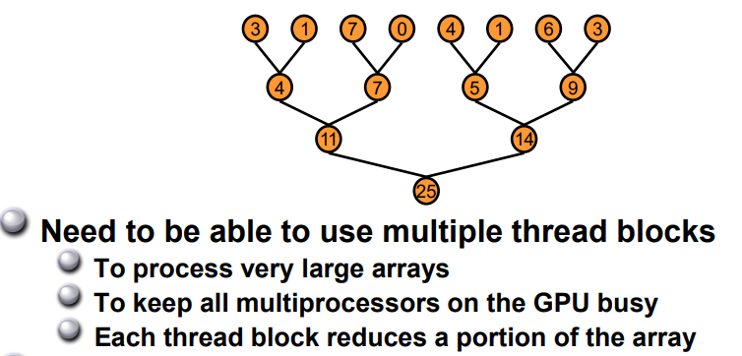
Parallel reduction
accelerate in Method step
two level : ①shared memory ② warp

Slide 7
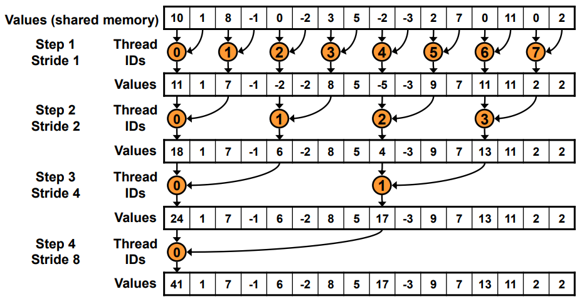
example (bank conflict)

Slide 8
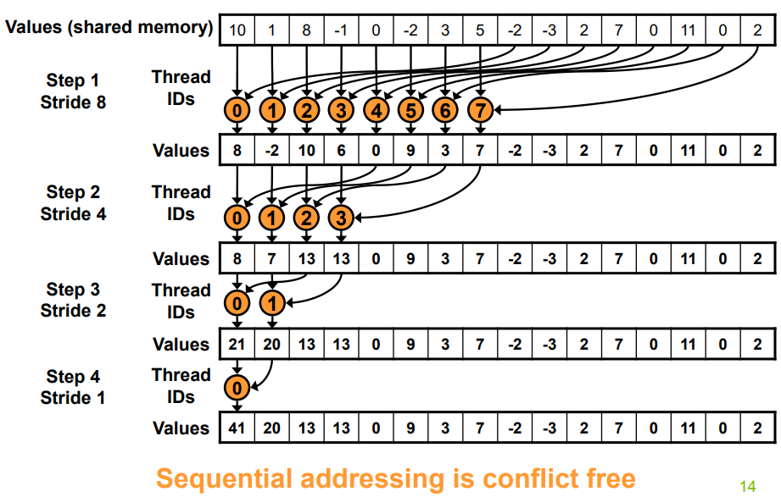
example (conflict free)

Slide 9
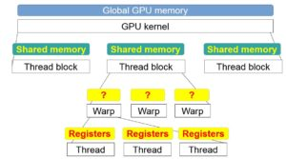
In warp
When s <= 32, we have only one warp left
Instructions are SIMD synchronous within a warp.

Slide 10
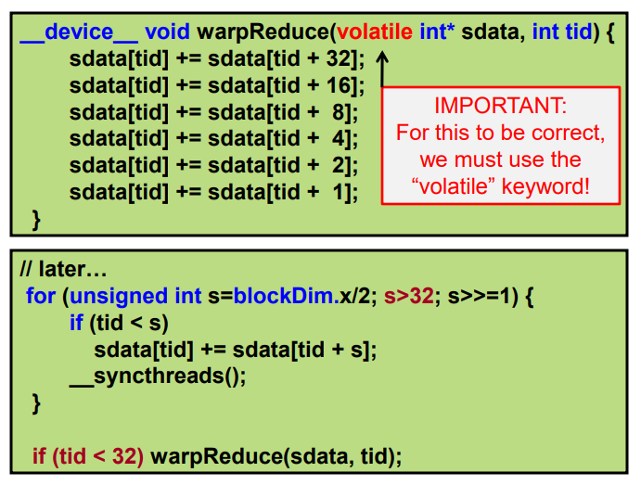
Code
warp
shared memory

Slide 11
Multi electrode dillemma
How to rotate these two squares to get the biggest overlap area?
a). rotate one square one time
(local extremum)
b). rotate two squares simutaneously
(expensive in calculating)

Slide 12
函数名称调用结构图
ROI
CORTEX
MORE2
output:
T1
T2
T3, U3
U(S2U)

Slide 13
More2 算法说明（need update)
More2
More2b: cublas to kernel function
More2c: blockSize/gridSize of kernel function
More2d: parallel design
1. 一次分配Ki*N 个线程计算Ki个C （速度不变）
2. 分配Ki个block，每个里面1024个线程（400ms -> 450ms)

Slide 14
T4m
U4m

Slide 15
3 levels in TIs’ parameters
1. the number of electrodes
2. the power exponent of ratio
3. add the penalty

Slide 16
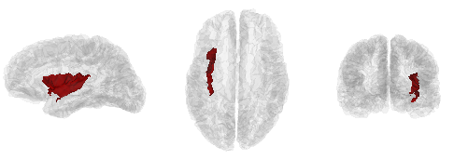

Slide 17
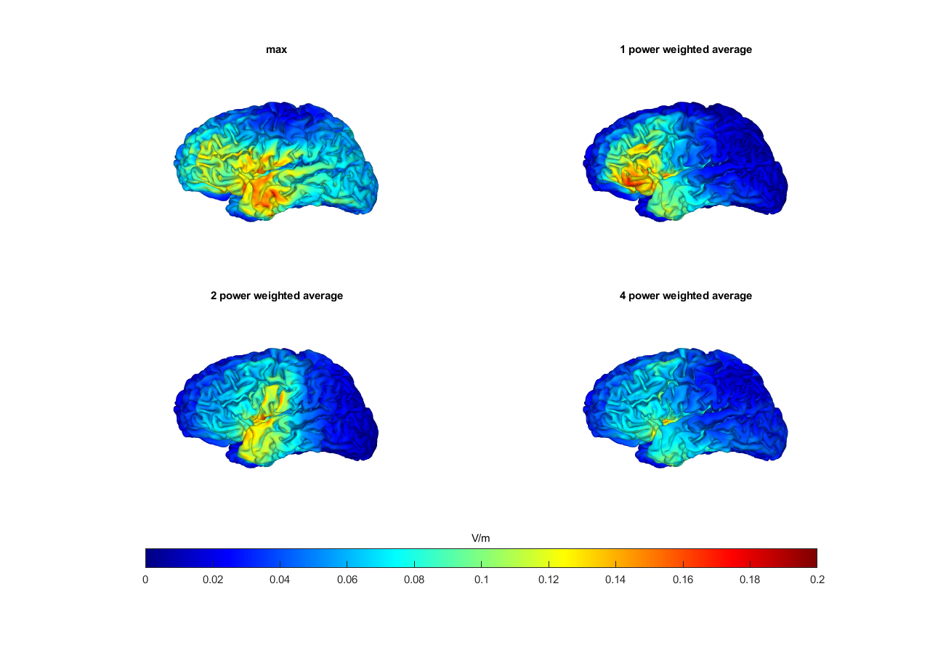

Slide 19
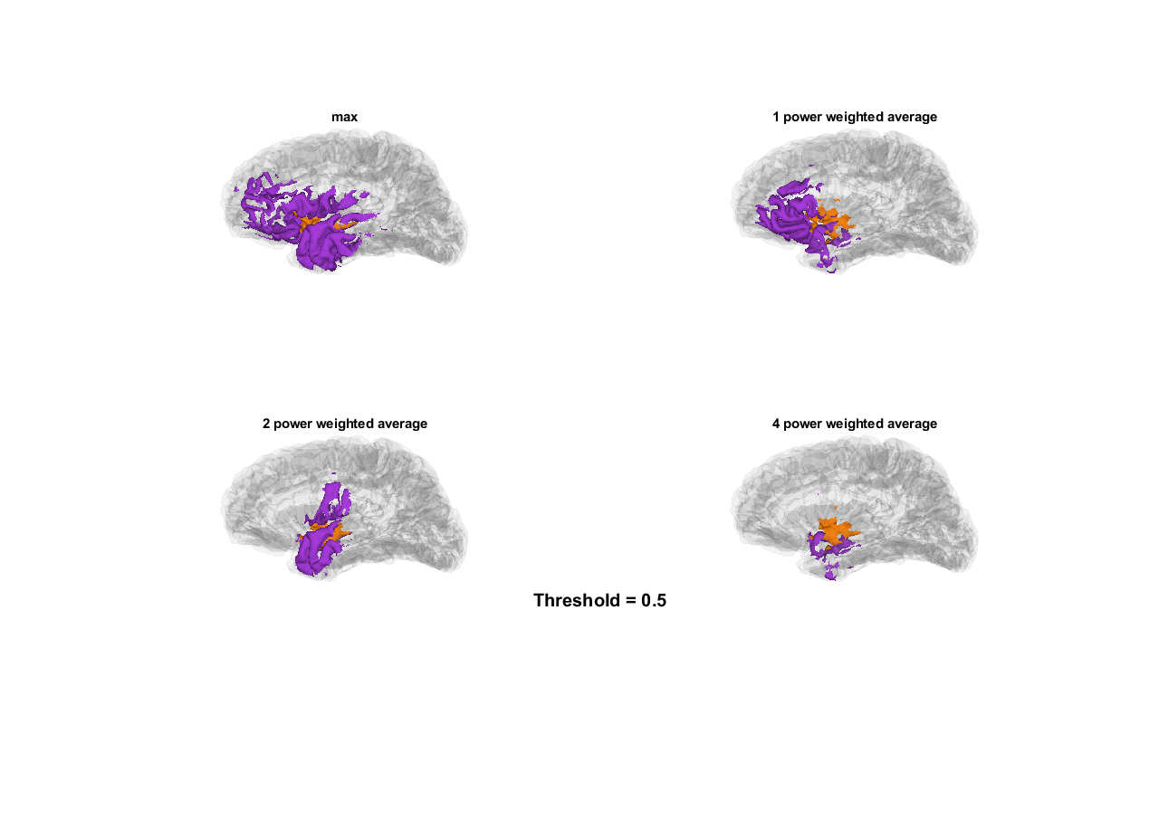

Slide 22
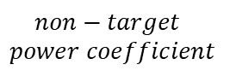
(A)
$$non−target$$
$$power coefficient$$
0
1
2
4
(B)
Target
Non-target

Slide 23
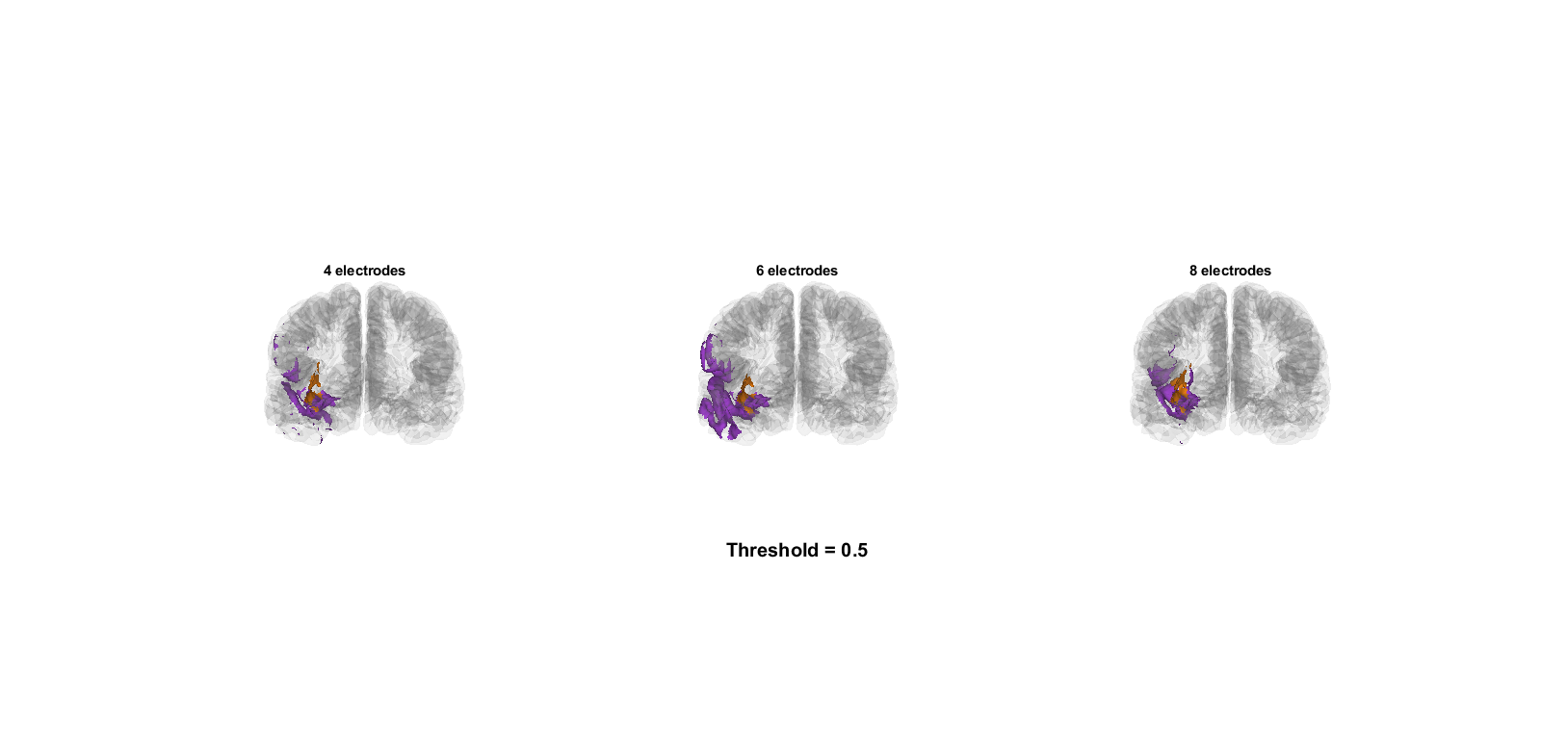

Slide 24
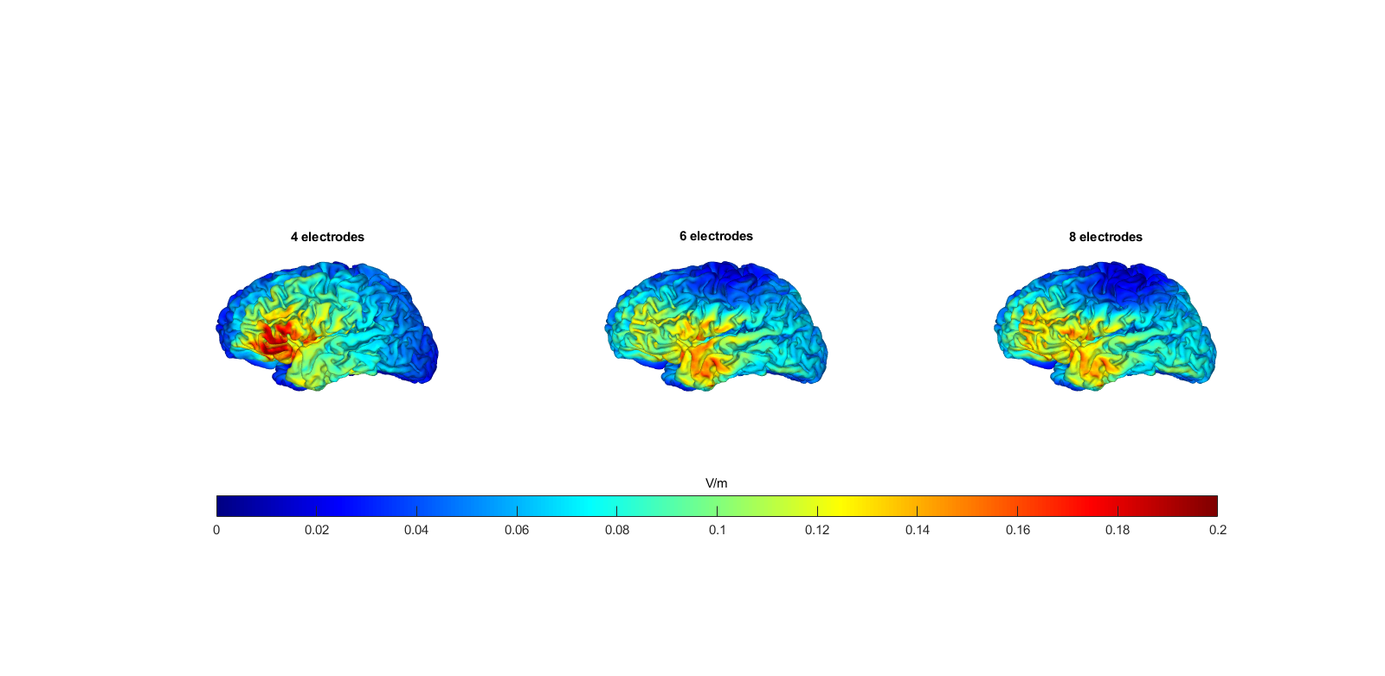
Notes:
Elec 原图1

Slide 25
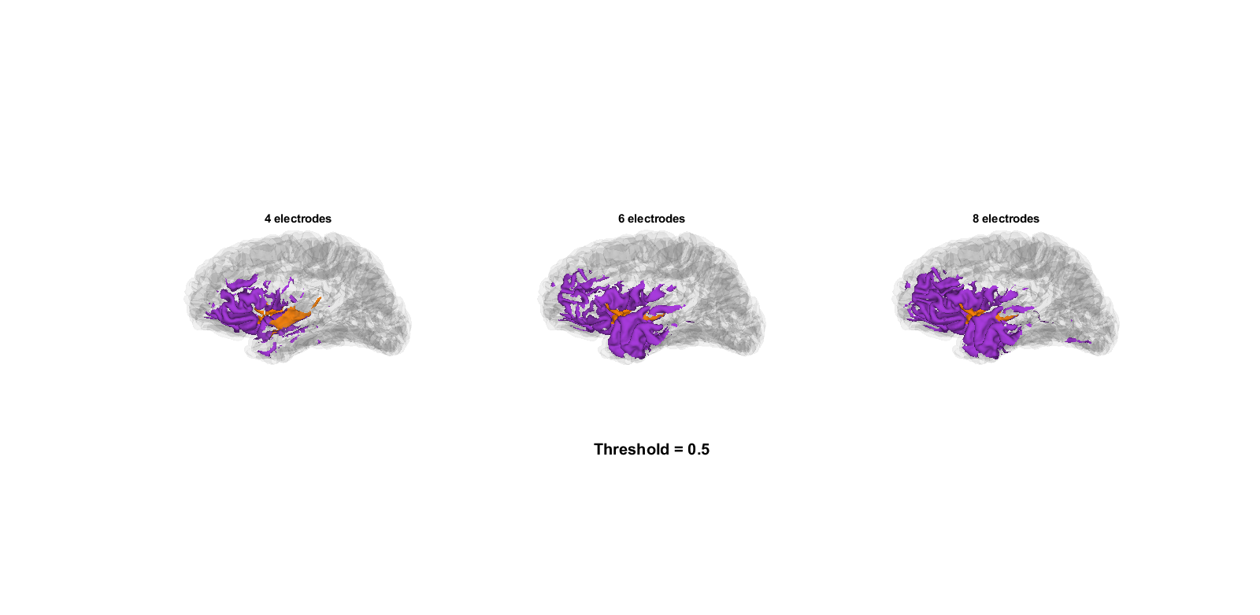
Notes:
Elec原图2

Slide 26
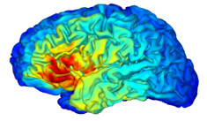
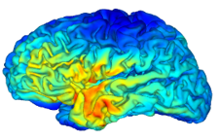
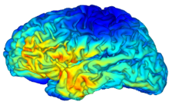
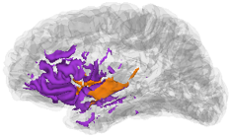
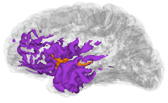
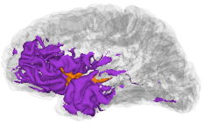
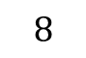
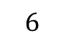
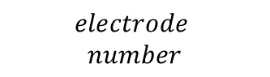
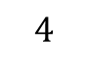
(A)
$$electrode$$
$$number$$
$$4$$
$$6$$
$$8$$
(B)
Target
Non-target

Slide 27
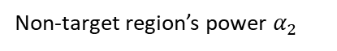
Non-target region’s power $α_{2}$

Slide 28
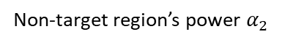
Target
Non-target
Suprathreshold brain area proportion
Suprathreshold brain area proportion
Non-target region’s power $α_{2}$
Electrode number

Slide 29
Distance to gravity center (mm)
Non-target region’s power $α_{2}$
Electrode number

Slide 30
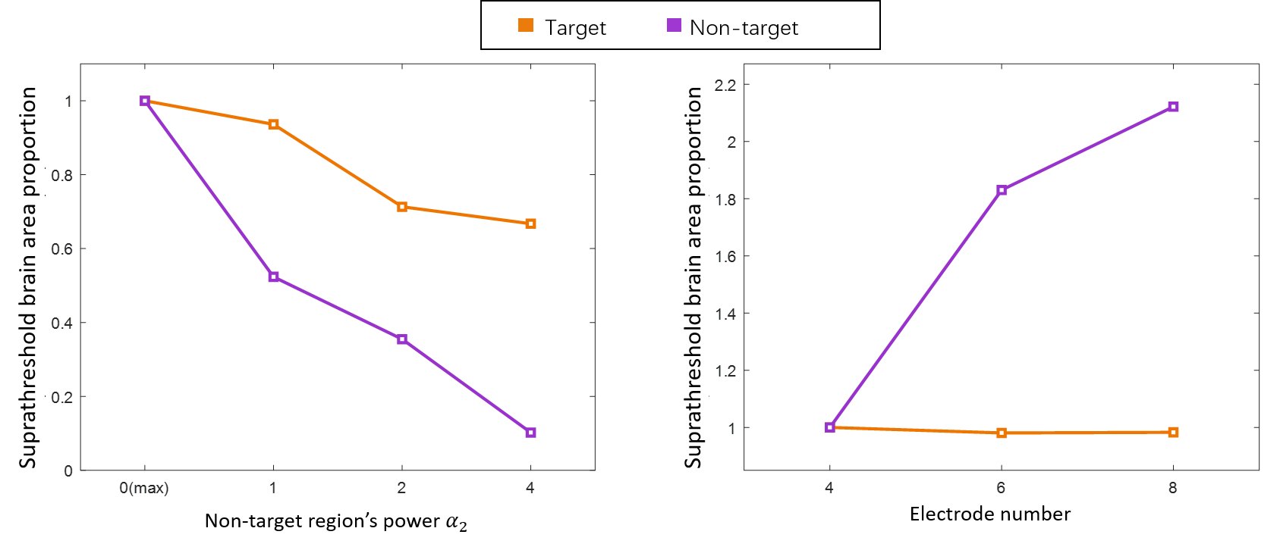
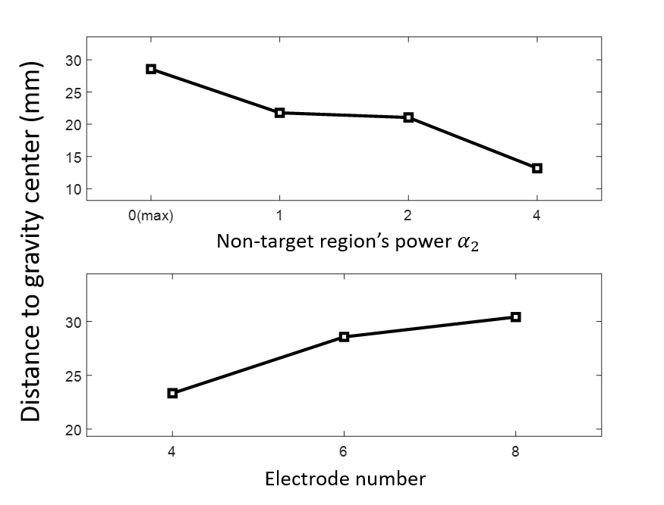
(A)
(B)
(C)

Slide 31
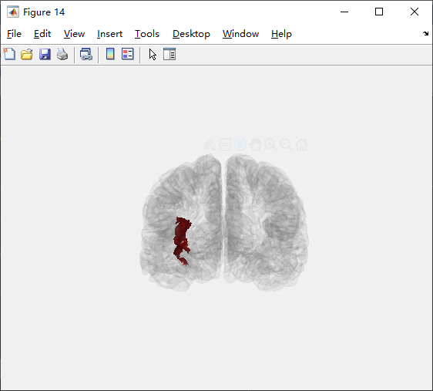
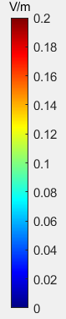
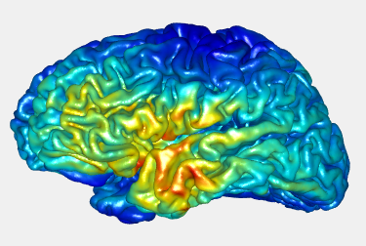
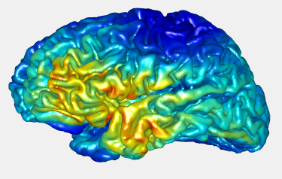
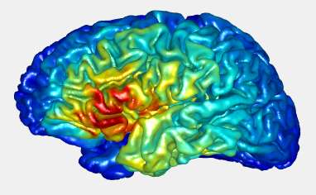
4-》6-》8 method: 0 / 0
Peak Ratio: 1.1143
1.1809
1.199

Slide 32
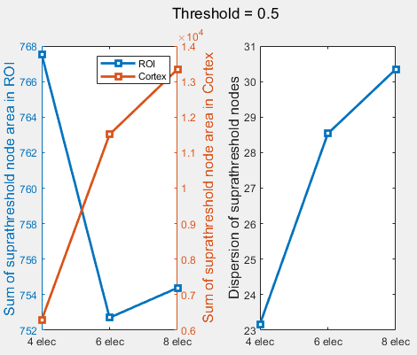
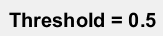
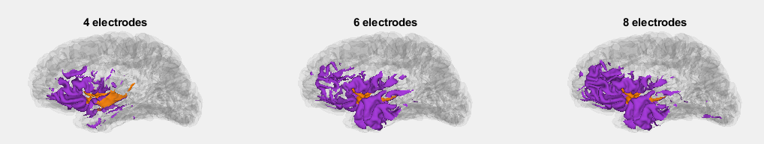

Slide 33
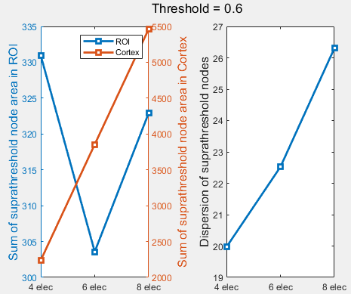
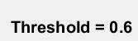
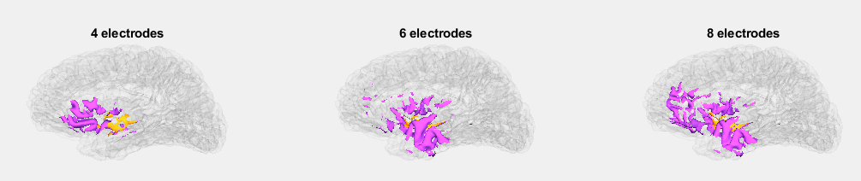

Slide 34
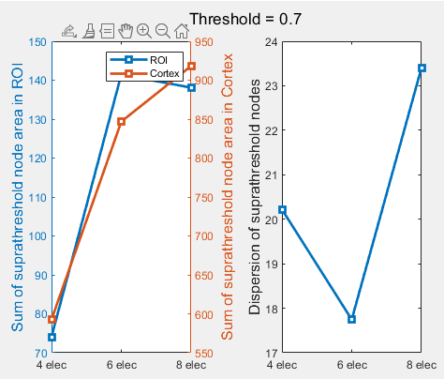
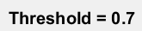
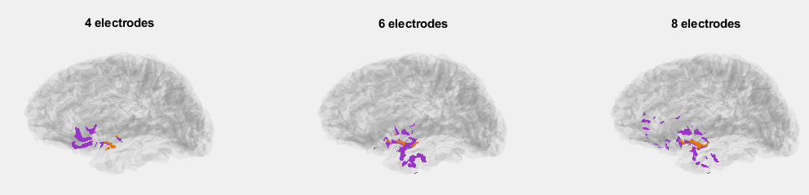

Slide 35
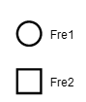
mA

Slide 36
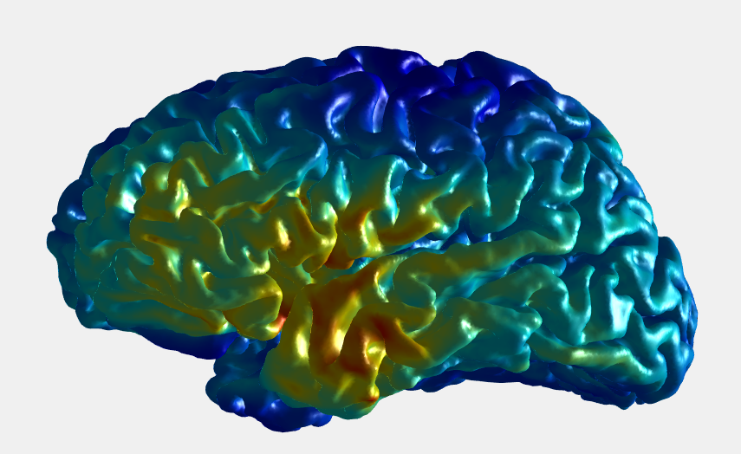
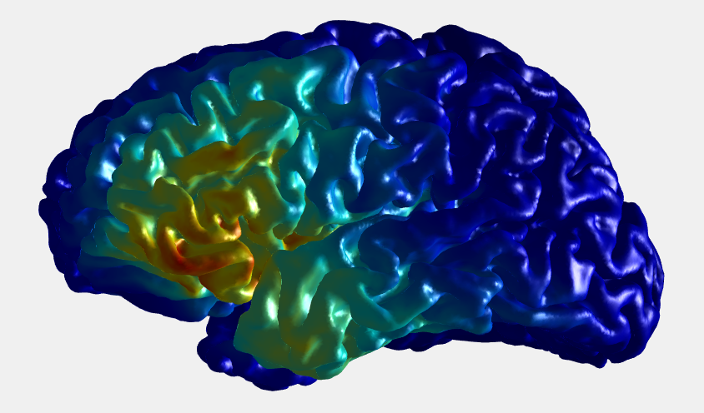
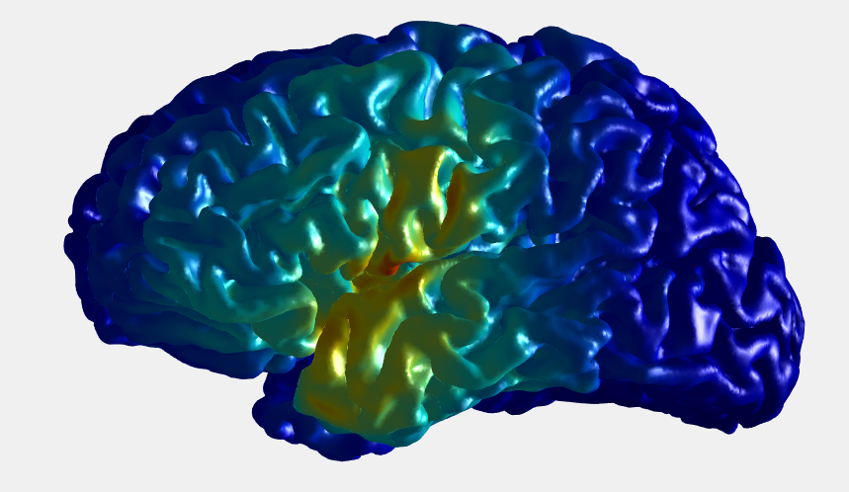
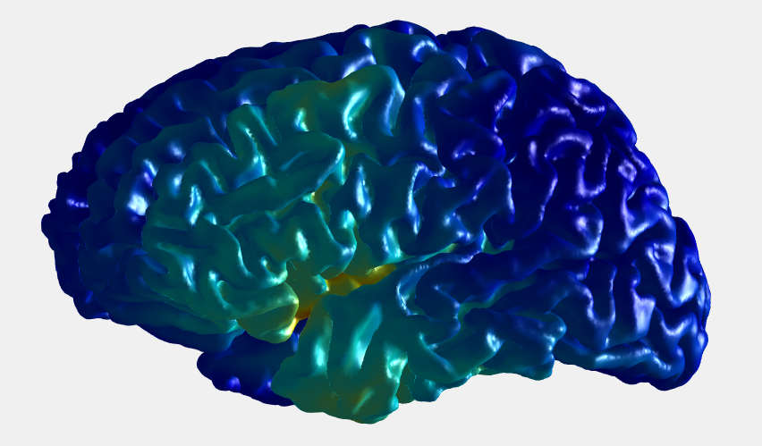
method_ROI = 0 (max) (elec = 6) method_Cortex: 0>1>2>4
0
1
2
4

Slide 37
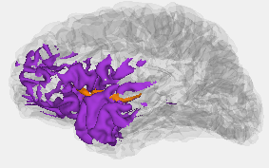
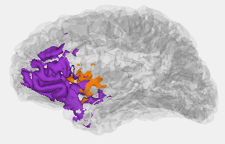
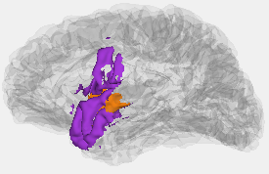
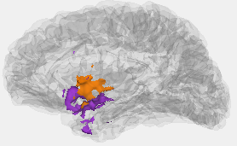
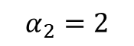



$$α_{2}=0 (max)$$
$$α_{2}=1$$
$$α_{2}=2$$
$$α_{2}=4$$

Slide 38
Suprathreshold brain area proportion
Average distance to gravity center(mm)

Slide 39
0
1
2
4
mA

Slide 41


Slide 42

ACC vs DLPFC

Slide 43


Slide 44


Slide 45


Slide 46

$$penalty$$
$$coefficient$$
1
2
2.5
3
(A)
(B)
Target
Penalty
Irrelevant

Slide 47
Suprathreshold brain area proportion
Penalty coefficient

Slide 48




Maximize ACC without penalty
Max/max(6 electrodes)
Max/power(6) (6 electrodes)

Slide 49
定义惩罚区域（ACC vs DLPFC)

Slide 50


Penalty coefficient (p=5)
Max/max(6 electrodes)
(P = 1 contrast)

Slide 51





Slide 52



P = 5, power2/power4, 6 electrodes

Slide 53
1
2
2.5
3
mA

Slide 54












CPU
大脑区域的划分
备选电极位置排列组合
目标区域
无关区域
脑网格内逐点求解两向量投影最小值问题
GPU
$$最大值max({ E1)}^{ }/mean⁡(E2)$$
四导电极参数优化${\overline{E1}}^{α}/{\overline{E2}}^{β}$
$$能量max({ E1)}^{ }/mean⁡(E2²)$$
$$均匀性mean({ E1²)}^{ }/mean⁡(E2)$$
六导电极参数优化
$$聚焦性mean({ E1²)}^{ }/mean⁡({E2}^{4})$$
八六导电极参数优化

Slide 55

高频电场A:2000HZ
振幅（mA)
时间（ms）
高频电场B:2020HZ
振幅（mA)
时间（ms）
低频耦合电场（20HZ)
振幅（mA)
时间（ms）

Slide 56


Slide 57


Slide 58



4个电极（每个频率2个）
6个电极（每个频率3个）
8个电极（每个频率4个）
低频耦合电场强度（V/m)

Slide 59


Slide 60




最大值
加权平均值
加权均方值
加权四次方值
低频耦合电场强度（V/m)

Slide 61
Hdf5文件
ernie_leadfield_EEG10-10_UI_Jurak_2007.hdf5
1*2 struct
/mesh_electrodes
/mesh_leadfield

